Slide 1
WSU Pullman Undergraduate Student Technology Fee
Fiscal Year 25

Slide 2
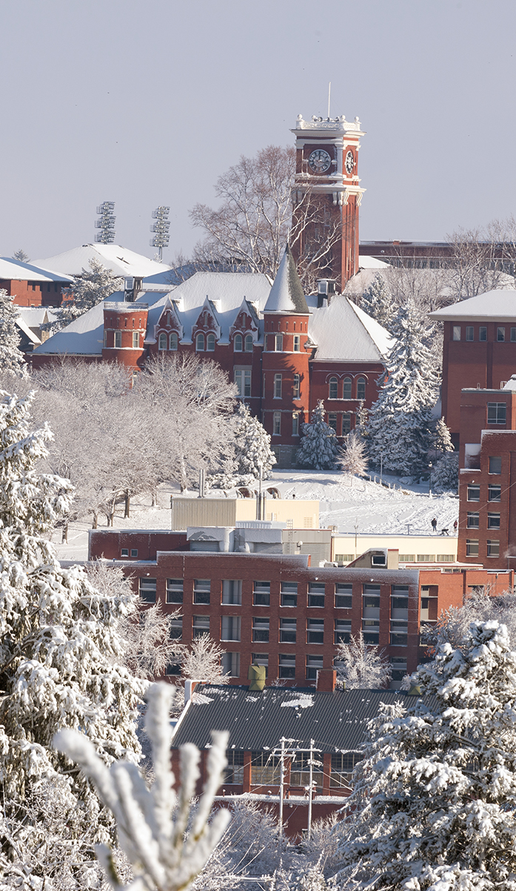

What Does the Fee Fund ?
Fee funds specific tech related projects which can be completed in one fiscal year.
Revenue from this fee shall be used exclusively for technology resources for general student use.
“Technology Fee” is a fee charged to students to recover, in whole or in part, the costs of providing and maintain services to the students that include, but are not limited to: Access to the internet and world wide web, email, software, and dial-up telephone services.
Only Undergraduates pay the fee.
RCW 28B.15.051
Past & Current Project Include:
  Student Printing
  ESports Gaming Lounge in Chinook
  Improvements to Wifi Infrastructure
  Creative Corridor Projects
  The Fiz

Slide 3

Request Materials
Standard Cover Form
  Project name, cost, organization and representatives
  Summary of project
    Includes numbers of students project will serve.
  How does project support student technology needs
  Identify five (5) priorities for funding
    If project does not allow for priorities, please provide scalable options for the committee to consider.
Standard itemization spreadsheet
Can include schematics, student petitions, or other supporting documents
Proposals that require any structure modifications must include estimate from facilities services in request.
Each group will present their request during the hearings. Each presentation will be 12 minutes.

Slide 4
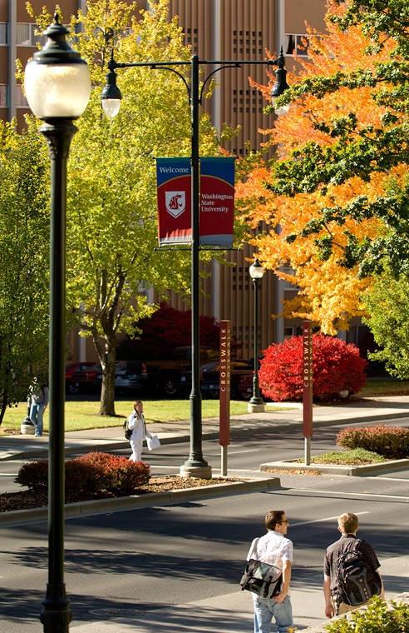
Notes to Groups
Keep presentations to no more than 5-6 minutes; maximize Q&A time.
Students must present. Staff/Faculty Reps attend hearings in support of student presenters.
Must include estimate from myfacilties for any structural modifications.
Requests must include signature for staff/faculty rep and area finance officer.
Requests must be limited to a single fiscal year.
Allocation request is two (2) step process:
  1. Written proposal (cover sheet + itemized spreadsheet)
  2. Presentation to committee
  **Groups must complete both steps to be considered for funds.**

Slide 5
Timeline
Deadline for
requests
Budget / Request Review
Hearings
Deliberations
Allocation Decisions sent to ASWSU for approval
Allocation Memo sent to Board of Regents via Chancellor and President for final approval.
Allocation Memo sent to WSU Pullman Chancellor
Initial Meeting
October
November 3
November 6
November 6-7 (13, if necessary)
November 13 (14, if necessary)
February 5

